Slide 1
BFB Project presentation
Minghao Liang, Ruofan Shi, Srinivas Gudipudi
Notes:
Main title: 40 pt. Arial
Presenter Name: 16 pt. Arial
Presenters Title: 16 pt. Arial Italic

Slide 2
Introduction to BFB
What it is?
Introduce phases
See levenspiel for more information

Slide 6
Literature approach
1.Briefly talk about the ODEs
2.Assumptions(most can be found in levenspiel)
3.What is the result?
4.Compare with levenspiel

Slide 7
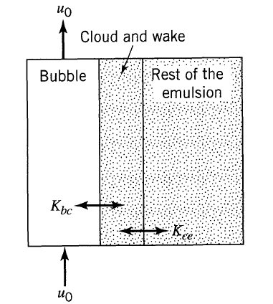
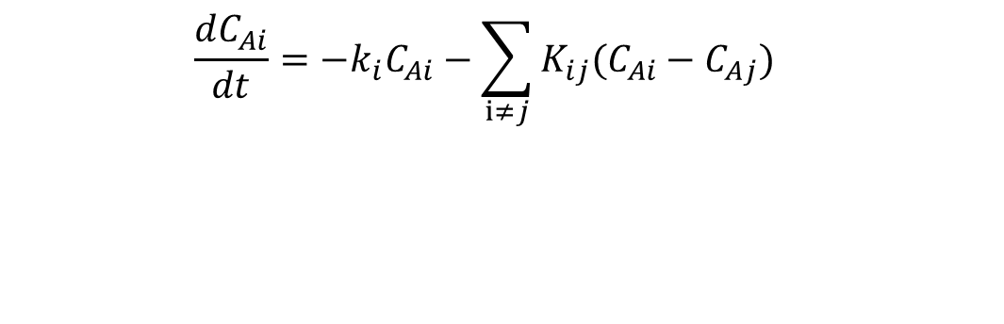
Mass balance(general form)
Reaction term
Mass accumulation
Mass transfer between phases
Where subscript i, j denote two different phases which must be adjacent
‘b’ for bubble phase
‘c’ for cloud phase
‘e’ for emulsion phase

Slide 8
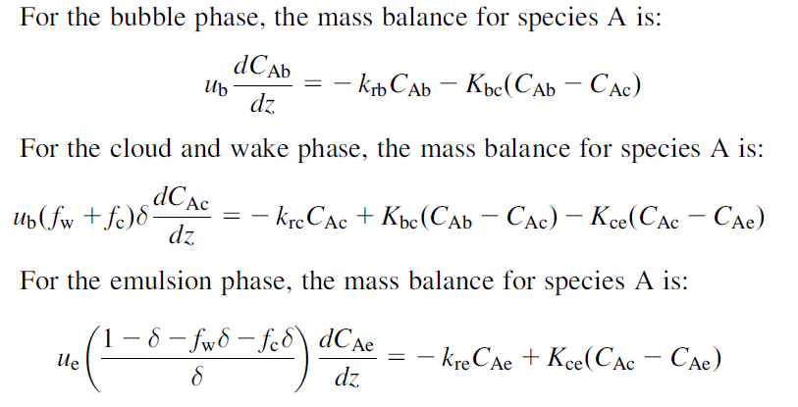
Mass balance

Slide 9
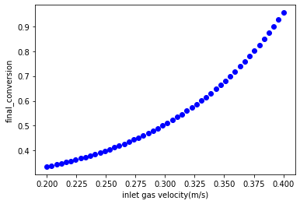
Influence of inlet gas velocity on conversion
The graph shows that the conversion increases with the inlet gas velocity.

Slide 10
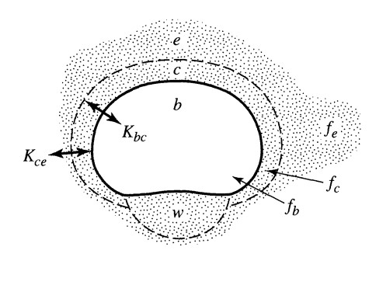
Approach 2：Membrane Like Reaction
Assumptions:
Fully Developed
Spherical Shape
C_{A0}=C_{Ab0}
Steady State
Constant T and P
Mass Transfer Constants

Slide 11
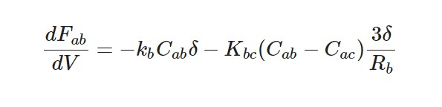
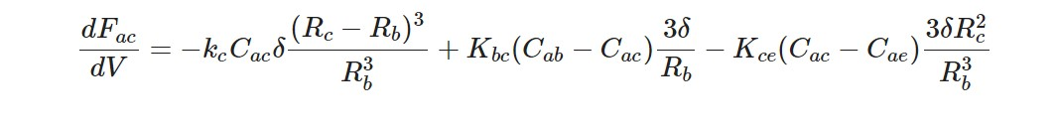
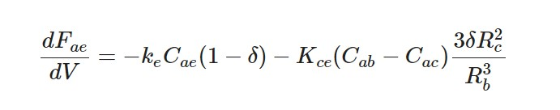
ODE Expression
Bubble Phase :
Cloud Phase :
Emulsion Phase :

Slide 12
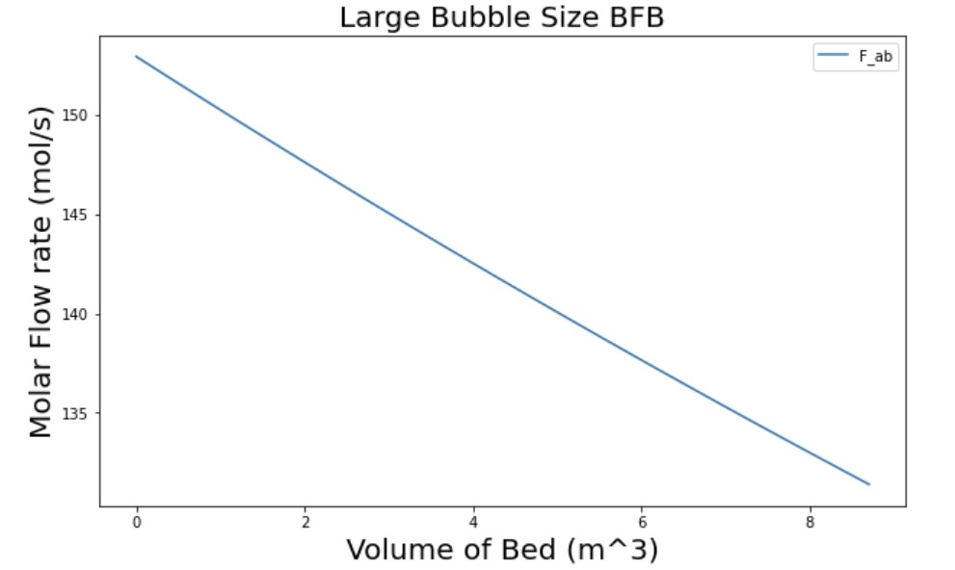
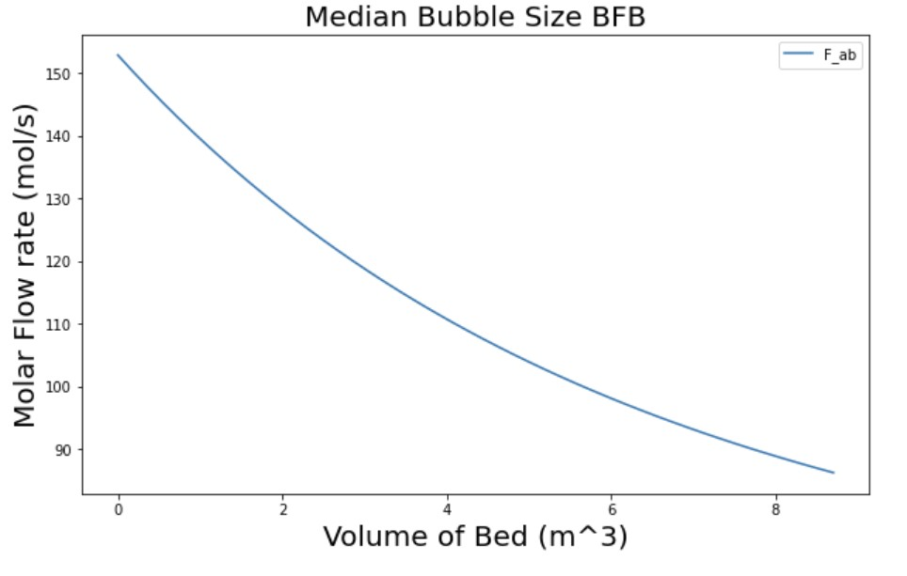
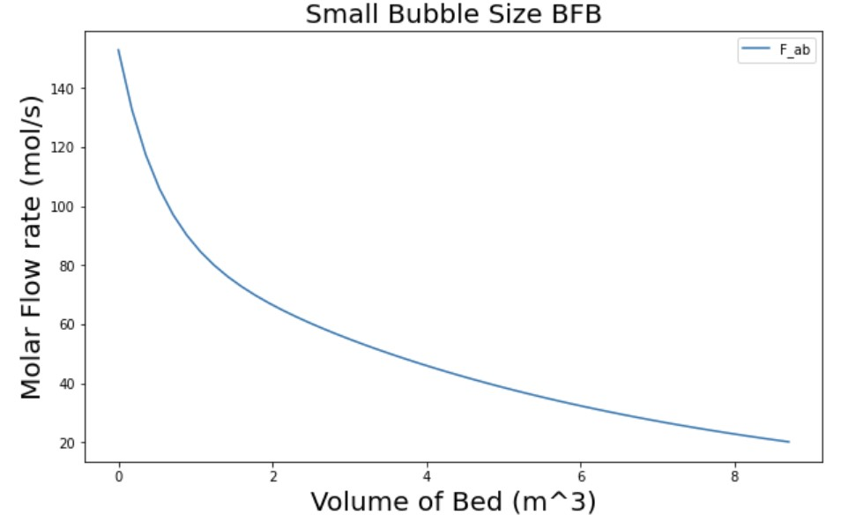
Bubble Size Comparison
14% Conversion
87% Conversion
43.58% Conversion

Slide 13
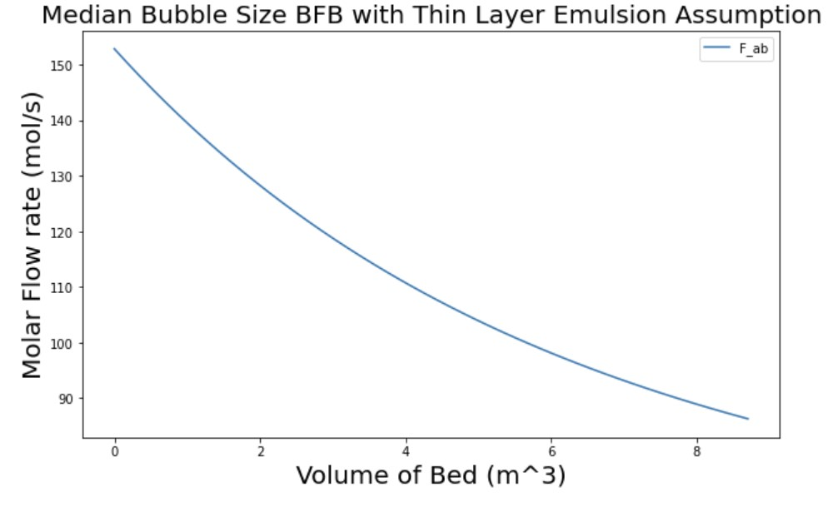

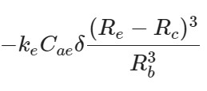
Emulsion Assumption Comparison
43.58% Conversion
43.56% Conversion

Slide 14
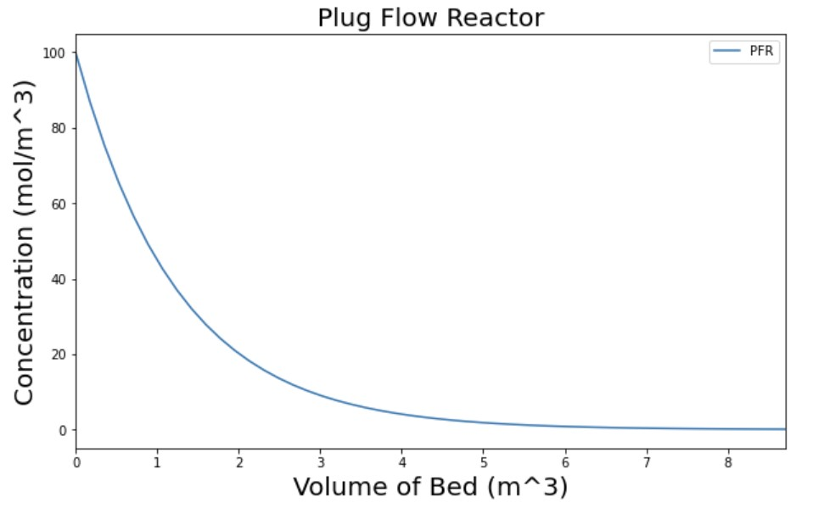
Plug Flow Reactor
99% Conversion
87% Conversion

Slide 15
Reference ?
Levenspiel, Octave. Chemical Reaction Engineering, 3rd Edition, Wiley, New York , 1999, pp. 446–465.
Li, Shaofen, et al. Reaction Engineering, Butterworth-Heinemann, Elsevier, Oxford, United Kingdom, 2017, pp. 380–386.

